Slide 1
Highly Effective Troubleshooting
Performance Tuning
Jobin Augustine PostgreSQL Escalation Specialist

Slide 2


Databases run better with Percona

Slide 3
Representing Real world cases
Common mistakes
Most Frequent troubles
Performance and Stability issues at Database Server
Host machine configuration & performance
PostgreSQL performance and stability
Right sizing and get maximum out of investments
Design & Development practices
What is not covered
SQL tuning

Slide 4
Three Sources
Three Sources of Problems
Host Machine / Infrastructure
PostgreSQL Configuration
Workload
Three sources of Information
Host Machine - Linux tools
PostgreSQL performance statistics and metadata
PostgreSQL logs

Slide 5

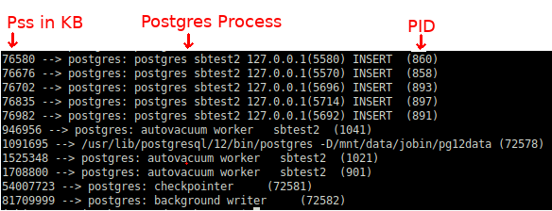
Host Machine Memory
Database servers needs lots of RAM
Transparent Huge Pages (THP) vs Persistent HugeTLBfs - Regular huge pages

Slide 6
Transparent Huge Pages (THP)
THP is bad for database workload
Causes fragmentation and memory allocation delays
Disable THP
Disabling THP at boot loader is recommended

Slide 7
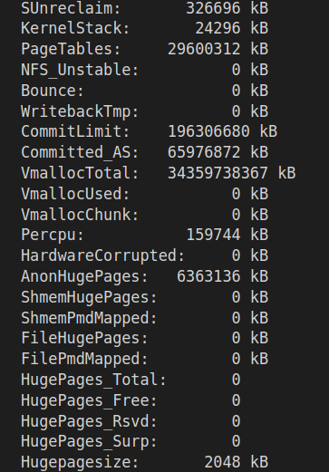
THP impact
29GB
$cat /proc/meminfo

Slide 8
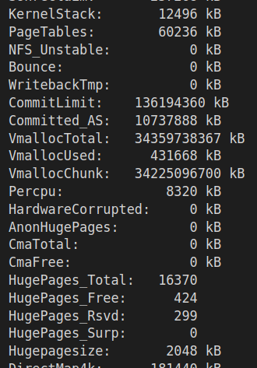
Persistent hugetlb pages - Regular huge pages
60MB
32GB
Notes:
PostgreSQL 14 allow users to specify a non-default huge page size which is available from Kernel 3.8
huge_page_size

Slide 9
Lot more …
CPU & Memory
Reduce swappiness
Storage
Filesystem
EXT4 and XFS
Mount option - noatime, nobarrier
Old partitions to compressed storage - zfs
vmstat
mpstat
iostat
pidstat
df
dmesg
lsblk
Recommends : Percona Toolkit - pt-summary

Slide 10

PostgreSQL performance and stability

Slide 11
Database workload is
generally I/O intensive
WAL Generation - transactions (DMLs)
Datafile reads - Active dataset is bigger than cache / buffer
Datafile writes - bgwriter, checkpointer, sessions
Autovacuum workload
Temporary files - Sort / Merge operations
Temporary tables.
PostgreSQL log
Notes:
WAL generation happens whenever a page is modified.

Slide 12
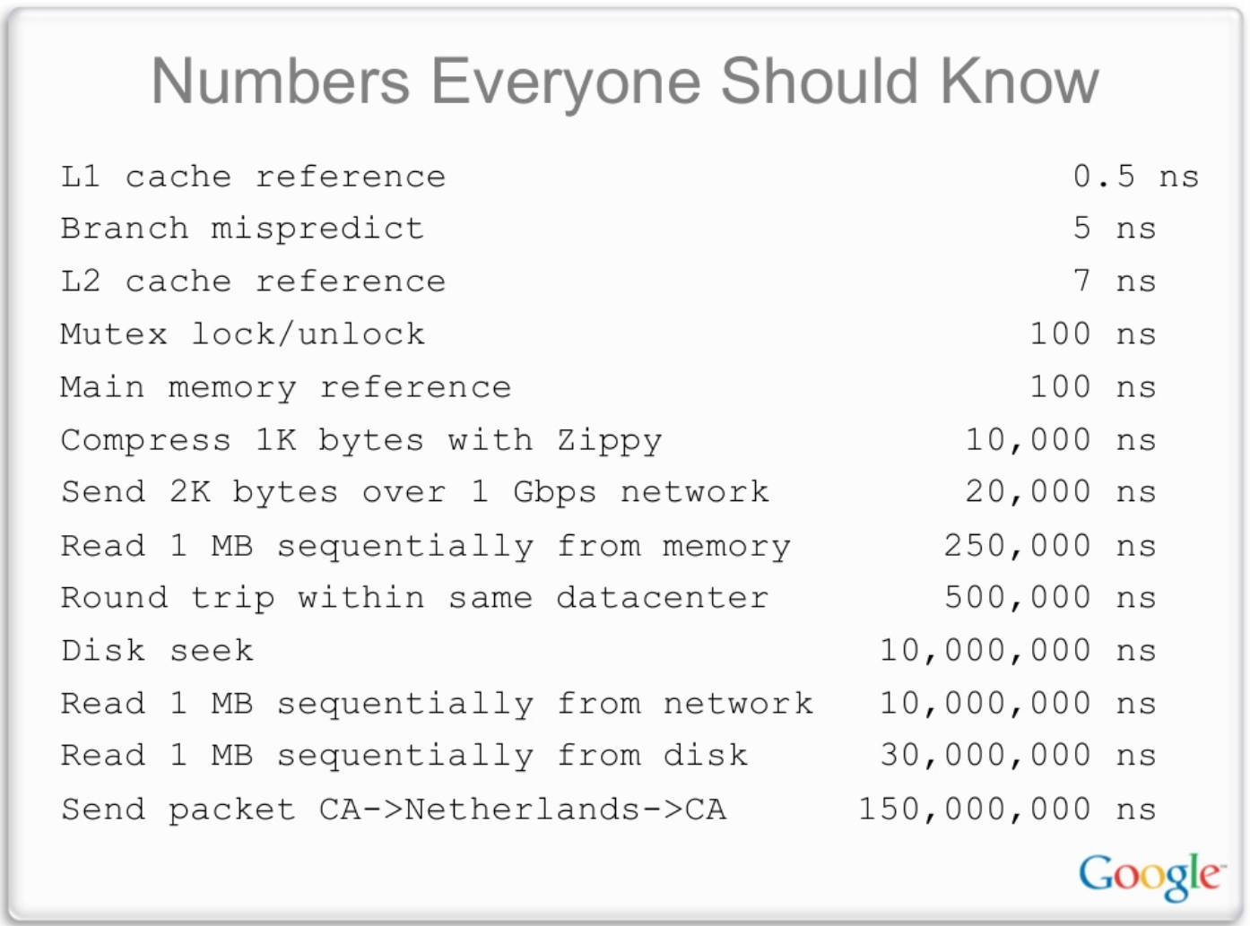
Notes:
jeff dean

Slide 13
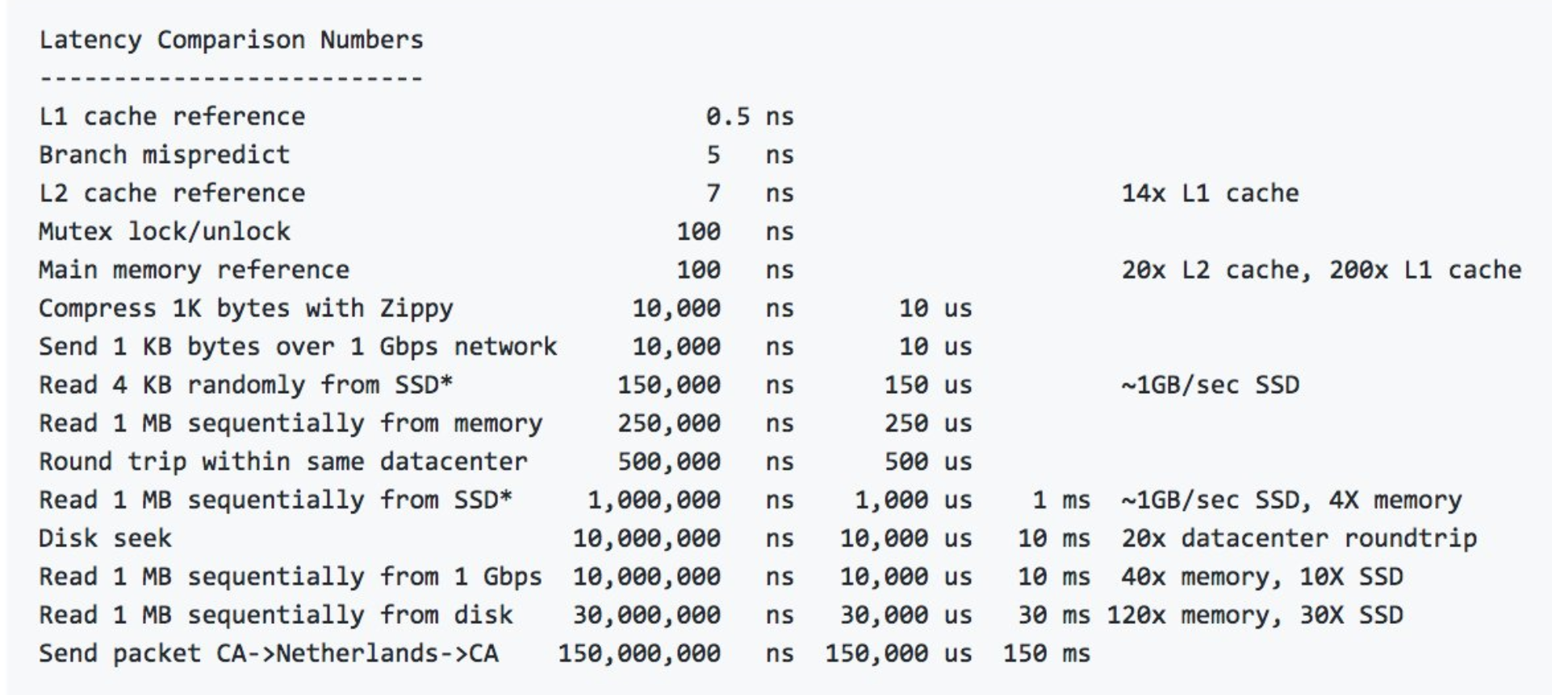
Notes:
One might argue that We have SSDs and NVMe

Slide 14
Connection management
Handshakes
Process forking
Authentication & Authorization
Allocations and settings
Analysis
PostgreSQL logs - log_connections
Statistics views (pg_stat_activity)
Notes:
Example, a monitoring tool creating a fresh connection for checking replication status Both Options need extraction + calculations

Slide 15
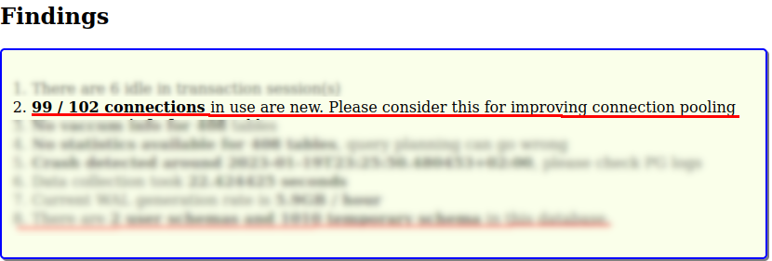
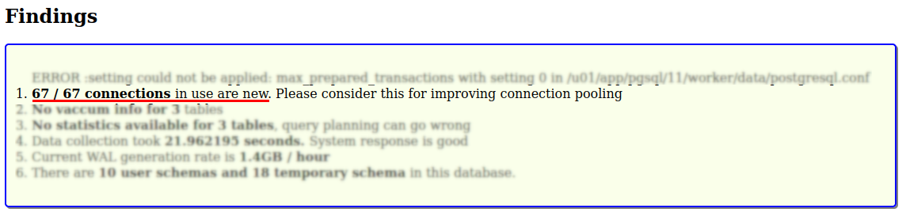
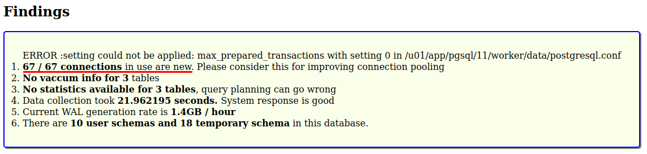
Tooling
Notes:
You need a tool which highlights the problem that connection management is messed up.

Slide 16
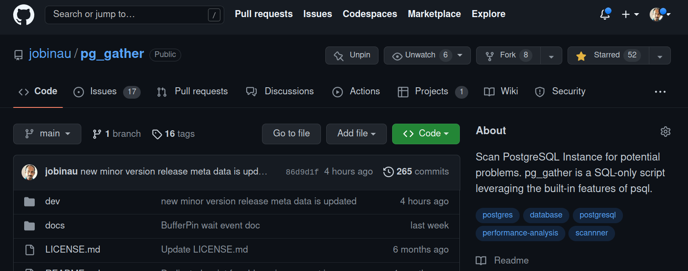
pg_gather
https://github.com/jobinau/pg_gather
Notes:
Thats what we started at Percona, Fernando, Nickolay , Sergey

Slide 17
Connection Management
Tune application layer pooler if any
Consider external pooler if required
Features
Reducing the re-connection overhead
Reduce the “idle” sessions.
Connection queueing

Slide 18
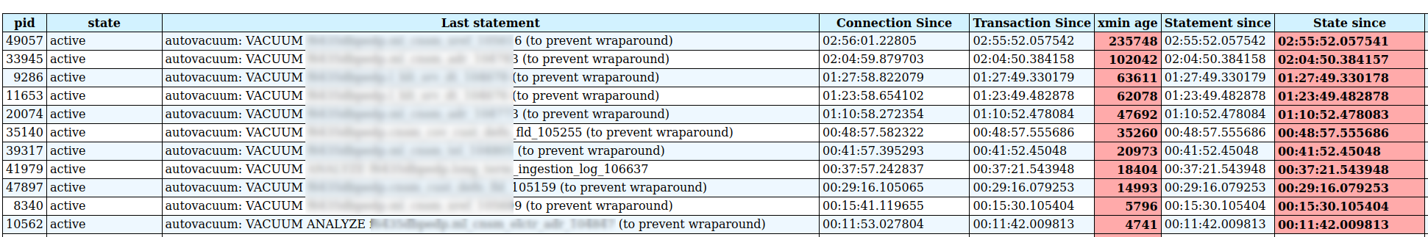
Autovacuum
* Information form pg_stat_activity after analysis
Notes:
Too many autovacuum workers (there was a case of autovacuum_max_workers=200 in CS0031464)
workers are running for several hours
They are all holding on to old xmin references
Age is increasing

Slide 19
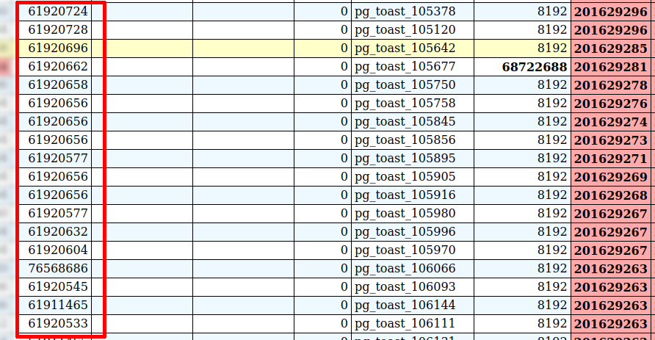
Wraparound prevention autovacuum
select n.nspname, c.relname,c.relpages::bigint blks,pg_size_pretty(pg_table_size(c.oid)) tot_tab_size,
pg_size_pretty(pg_relation_size(c.oid)) only_tab_size, pg_size_pretty(pg_total_relation_size(c.oid)) "tab+idx", age(c.relfrozenxid) tab_age,
t.relname as toast,t.relpages::bigint t_blks,pg_size_pretty(pg_table_size(t.oid)) toast_size, age(t.relfrozenxid) toast_age, GREATEST(age(c.relfrozenxid),age(t.relfrozenxid)) as greatest_age
from pg_class c
inner join pg_namespace n on c.relnamespace = n.oid and n.nspname not in ('pg_catalog','information_schema')
left join pg_class t on c.reltoastrelid = t.oid and t.relkind = 't'
where c.relkind in ('r','m')
order by 12 DESC
Notes:
toast can have different age.

Slide 20

Temporary Tables
Every session has to create the temporary table
Bloats catalog tables like pg_class, pg_attribute and causes server performance degradation
Temporary tables spill to disk and causes I/O

Slide 21
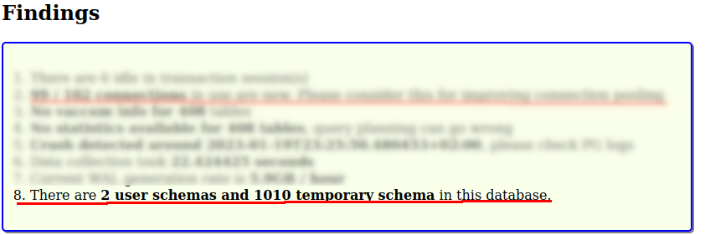
Temporary Tables - How to detect
The temporary tables are session specific. Unless the transaction which creates the temporary table commits, it won’t be visible for monitoring.
Notes:
Evidence detected by the existence of temporary schema

Slide 22
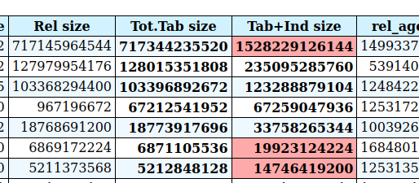
Indexes
are not always great
Every DML Operation need to update indexes
Indexes are WAL logged
Indexes are Cached /Buffered
Indexes Causes more Random I/O on datafile reads and writes
Indexes are to be vacuumed
Indexes penalize the entire system for speeding up particular query.
Sequential Scans are not bad always.

Slide 23
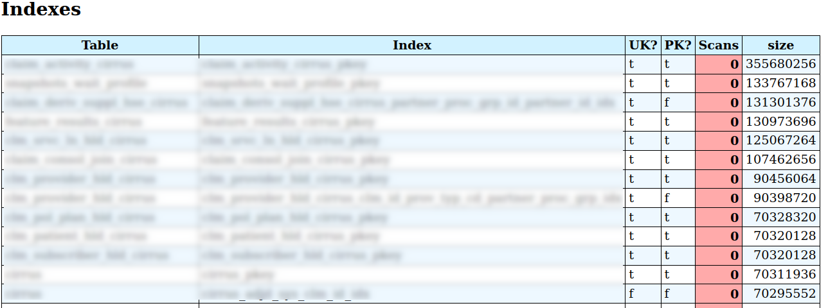
Indexes
idx_scan column of pg_stat_user_indexes
pgexperts /pgx_scripts: https://github.com/pgexperts/pgx_scripts/blob/master/indexes/unused_indexes.sql
Never Used, Low Scans, But high writes, Seldom used large indexes
pg_gather: https://github.com/jobinau/pg_gather
* PG 16 comes with last_idx_scan column
Notes:
Systems with terabyte size unused indexes

Slide 24

Foreign Keys
Checks are costly
Assess the use of FKs.
Fix application logic
NOT NULL column with right data type is good enough.
We are living in a world with NoSQL
INSERT INTO child (childid,parentid)
SELECT C1 , parentid FROM parent WHERE parentid=P1;
Notes:
Explain the cost while delete purging activity
Insert activity
lifting the training wheels - how expert DBAs gained additional performance.

Slide 25
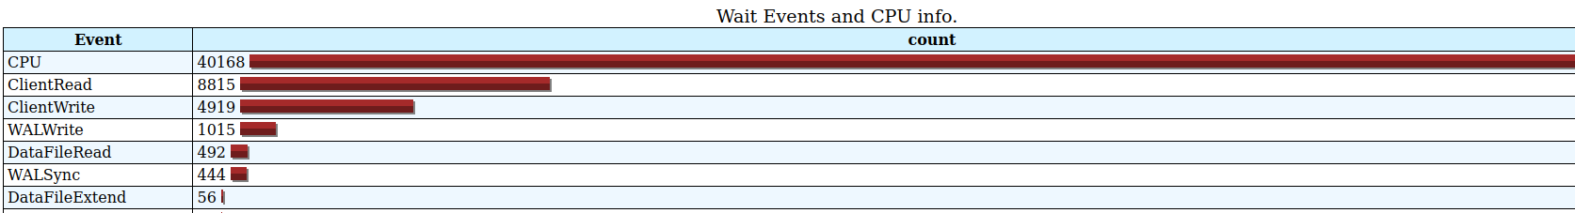
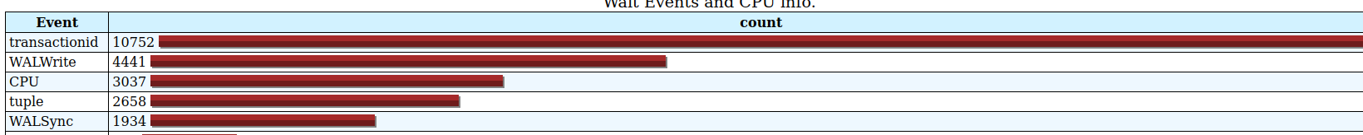
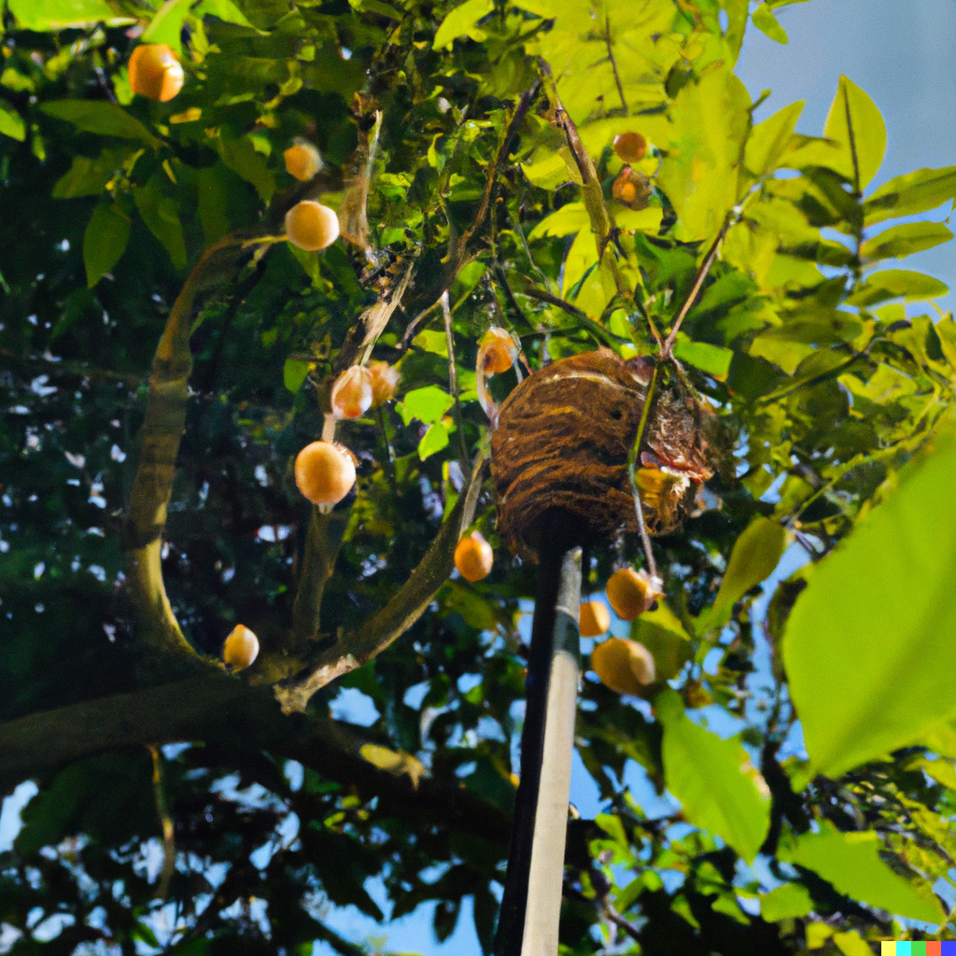
Using Wait events for tuning
The best way to understand the bottlenecks in the system
Move the pg_wal directory to another fast, low latency storage
Notes:
W

Slide 26
Spreading the I/O
Dedicated mount for WALs
Dedicated mount for temporary tablespace
Tablespaces.
Unlogged tables.

Slide 27
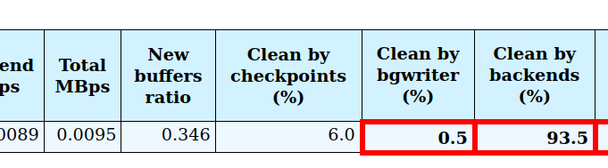
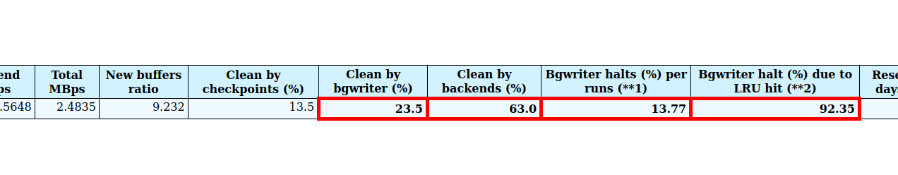
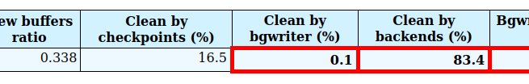
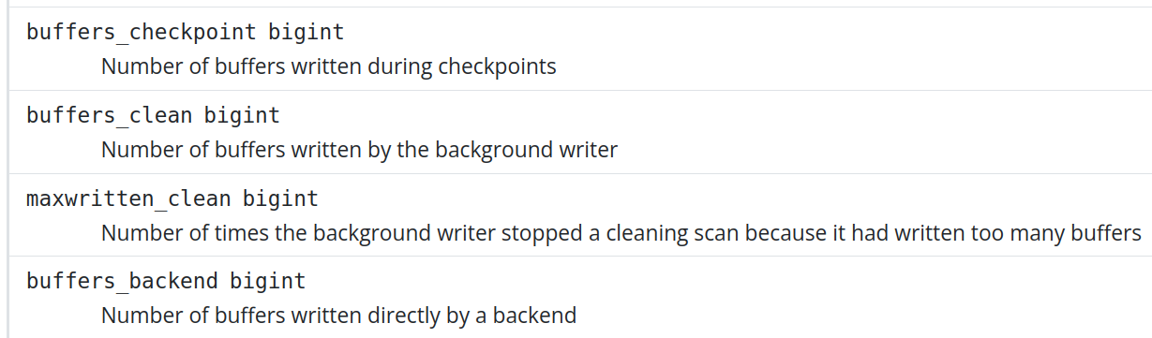
Dirty Page Writes
Data is available from pg_stat_bgwriter
Notes:
Explain dirty pages. Hi DML/Transaction activity
Finally explain the memory pressure. Investment in memory can save the system

Slide 28
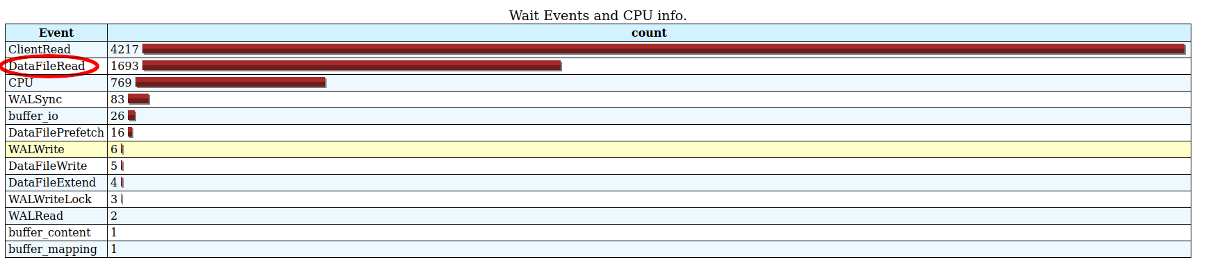
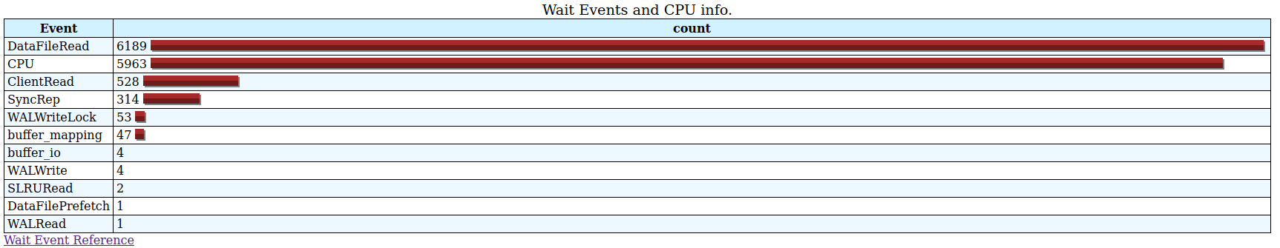
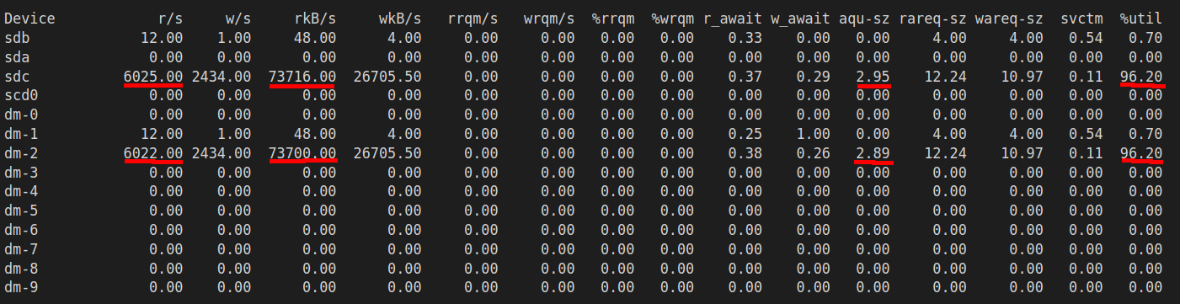
DataFileRead
Implementation of data retention policies (Archive and Purge)
Partition the big tables tables.
Remove Unused / Seldom used indexes.
Notes:
Select queries need more data. and cache is not helping. Explain the concept of Active dataset

Slide 29
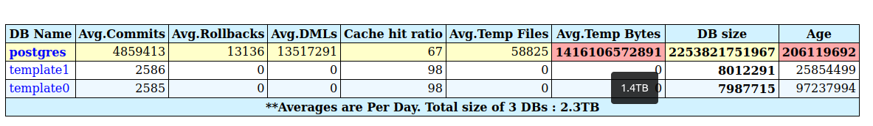
Poor Architecture
Transaction Management
Temporary file generation

Slide 30
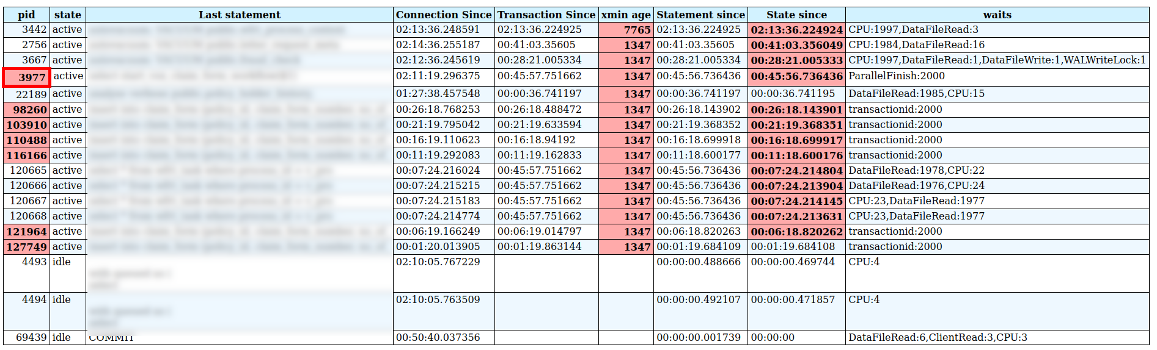
Contention / Blockings
Blockings can form long chains
Notes:
Explain the chain of blocking

Slide 31
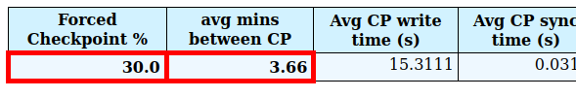
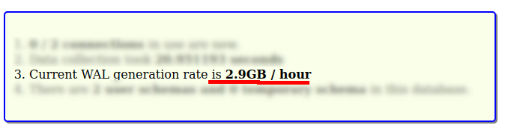
Configuration Problems
PostgreSQL default settings are not great for heavy workload
max_wal_size
min_wal_size
checkpoint_timeout = 900 -1800
Notes:
Atleast 1 hour of WAL retention.

Slide 32
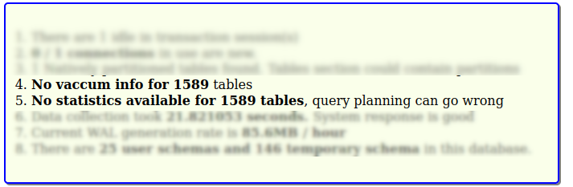
Configuration Problems

Slide 33
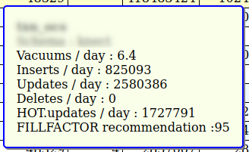
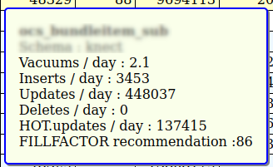
HOT updates
Heap Only Tuple Updates are cheap
It can prevent write amplification.

Slide 34
DBAs
Good DBAs influence the design and quality of system
Example :
Temp usage (temp_file_limit)
idle in transaction (idle_in_transaction_session_timeout)
Benchmarking - measuring the performance
Measuring the Availability
Identification of wastage, potential problems, bottlenecks.
Operations vs Dev mindset
Analyzing PostgreSQL logs

Slide 35
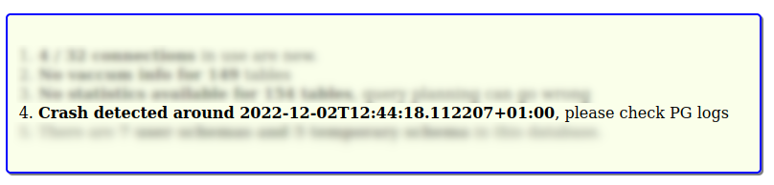
Crashes

Slide 36
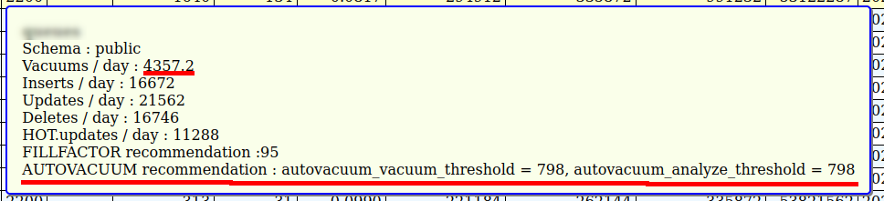
Table level tuning

Slide 37
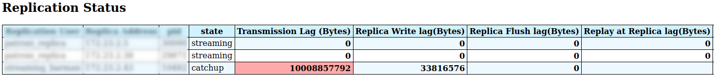
Replication

Slide 38
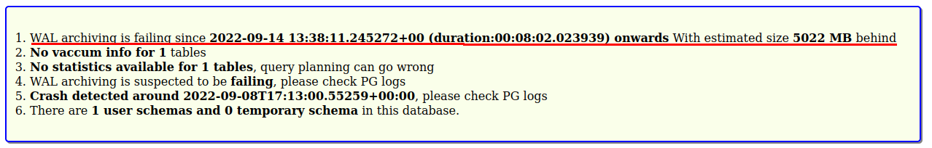
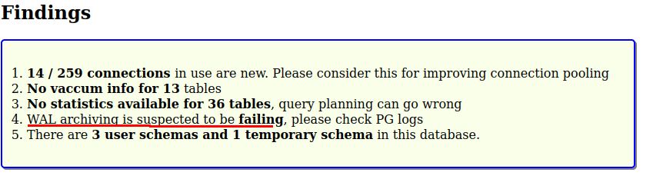
Failing WAL archiving
Information from pg_stat_archiver

Slide 39
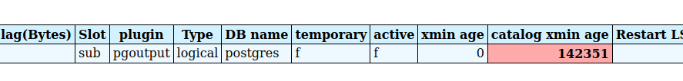
Abandoned replication slots
max_slot_wal_keep_size gives protection from outages
Information from pg_replication_slots

Slide 40
Summary
Three sources of Information.
PostgreSQL stats views gives immense information
Correlating the collected information and making a sense of it is important.
Tools are handy.
pg_gather
1. Collecting the data
psql -X -f gather.sql > out.txt
2. Importing the data
psql -f gather_schema.sql -f out.txt
2. Preparing report
psql -X -f gather_report.sql > GatherReport.html

Slide 41
Links
pg_gather:
https://github.com/jobinau/pg_gather
PMM
https://www.percona.com/software/database-tools/percona-monitoring-and-management
Percona Toolkit
https://www.percona.com/software/database-tools/percona-toolkit
pg_stat_monitor
https://github.com/percona/pg_stat_monitor

Slide 42


Slide 43
THANK YOU
Q&A

Slide 45
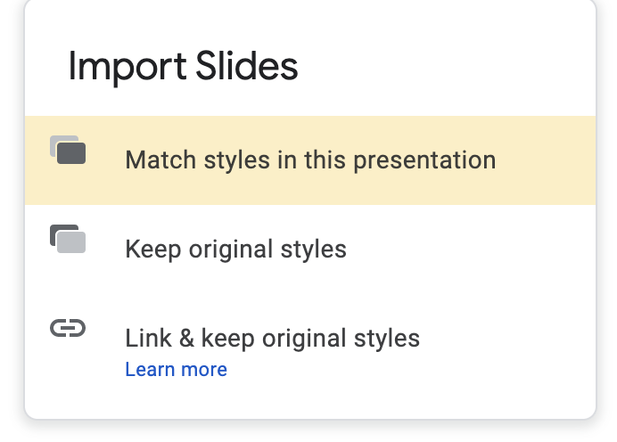
Importing slides from another slide deck
When importing another slide or slides to this presentation, please choose the option: Match styles in this presentation

Slide 46
Colour/Color Palette
#0e1a53
#5e6686
#ff7e1a
#ffc496
#f24500
#f9a98a
#1486ff
#93c7ff
#f0b336
#f8dca3
#30d1b2
#a0eadc
#a86fef
#d7bdf8
#697793
#bac0cd

Slide 47
Poppins Bold 25
Poppins Bold 25
Poppins Bold 25
Poppins Semibold Size 12
Poppins Semibold Size 12
Poppins Semibold Size 12
Poppins Normal size 13
Poppins Normal size 13
Poppins Normal size 13
Poppins Normal size 13
Poppins Normal size 13
Poppins Normal size 13
Poppins Normal size 13
Poppins Normal size 13
Poppins Normal size 13
Poppins Normal size 13
Poppins Normal size 13
Poppins Normal size 13
Poppins Normal size 13
Poppins Normal size 13
Poppins Normal size 13
Poppins Normal size 13
Poppins Normal size 13
Poppins Normal size 13
Poppins Normal size 13
Poppins Normal size 13
Poppins Normal size 13
Poppins Normal size 13
Poppins Normal size 13
Poppins Normal size 13
Poppins Normal size 13
Poppins Normal size 13
Poppins Normal size 13

Slide 48
Poppins Medium Size 34
Poppins Semibold Size 18
Poppins Normal size 13
Poppins Normal size 13
Poppins Normal size 13
Poppins Normal size 13
Poppins Normal size 13
Poppins Normal size 13

Slide 49
Timeline
January
February
March
Mid-March — Mid-April
April
Poppins Semi Bold Size 14
Poppins Semi Bold Size 14
Poppins Semi Bold Size 14
Poppins Semi Bold Size 14

Slide 50
Poppins Bold Size 17
Poppins Bold Size 17
Poppins Normal 12
Poppins Normal 12
Poppins Bold 24
Poppins Normal 16
=
Poppins Bold Size 17
Poppins Bold Size 17
Poppins Normal 12
Poppins Normal 12

Slide 51
Poppins Medium Size 34
Poppins Semibold Size 18
Poppins Normal size 13
Poppins Normal size 13
Poppins Normal size 13
Poppins Normal size 13
Poppins Normal size 13
Poppins Normal size 13

Slide 52
Poppins Medium Size 34
Poppins Normal size 11
Poppins Normal size 11
Poppins Normal size 11
Poppins Normal size 13
Poppins Normal size 13
Poppins Normal size 13
Poppins Normal size 11
Poppins Normal size 11
Poppins Normal size 13
Poppins Normal size 13

Slide 53
Title here - Poppins Medium size 34 colour #oe1a53
Poppins Normal size 20 - colour #oe1a53

Slide 54
Title here - Poppins Medium size 34 colour #oe1a53
Poppins Normal size 20 - colour #oe1a53

Slide 55
Poppins Medium S48
Poppins Normal Size 20

Slide 56
Title - Poppins Medium size 20
Text - Poppins Normal size 18
Title - Poppins Medium size 20
Text - Poppins Normal size 18

Slide 57
Title here - Poppins Medium size 34 colour #oe1a53
Subtitle Poppins Medium Size 20
Subtitle Poppins Medium Size 20
Text - Poppins Normal size 18
Text - Poppins Normal size 18

Slide 58
Poppins Medium size 18
Poppins Normal size 18
Poppins Normal size 18
Poppins Normal size 18
Poppins Medium size 18
Poppins Normal size 18
Poppins Normal size 18
Poppins Normal size 18

Slide 59
Add title here - Poppins Medium size 34 colour #oe1a53
Poppins Normal size 20 - colour #oe1a53

Slide 60
Poppins Medium Size 42
Poppins Medium size 30

Slide 61
Poppins Medium Size 42

Slide 62
THANK YOU!
percona.com

